Slide 1
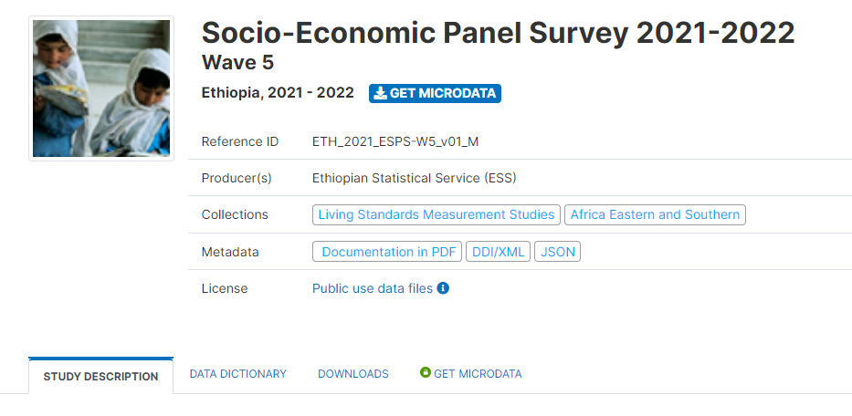




Ethiopia Socioeconomic Panel Survey
Accessing Microdata and Documents
January 26, 2024
Presented by ESS and LSMS teams
Notes:
Good morning; and Thanks, Manex for providing a wonderful summary of the survey result of the second phase of the panel. What is presented on the survey result is a tip of the iceberg but demonstrates how powerful the ESPS data is. The most precious gem is on the microdata. Hence my presentation will focus on how you can access the data.

Slide 2

WHY MICRODATA DOCUMENTATION AND DISSEMINATION?
Data are only useful if they are used
Data can be re-purposed
To be used, data must be:
Visible
Discoverable
Accessible
Usable
Documentation and dissemination of detailed metadata helps achieve these objectives
Data collected for one purpose have the potential to generate economic and social value in applications far beyond those originally anticipated.
World Development Report 2021

Slide 3
WHAT IS IN THE MICRODATA DOCUMENTATION?
Cleaned and Anonymized Microdata: All collected microdata as well as generated from microdata or other sources based on the microdata.
Study Description: Detailed information about the survey (study scope/coverage, sampling, contents of survey instruments, training of field staff, data confidentiality, etc.)
Data Description: Describes each data file in the Microdata library (file name, thematic/ subject matter of the data file, number of observations, number of variables )
Documentation: Supporting documents, including questionnaires, manuals, report, and basic information documents.

Slide 4
Basic Information Document (BID)
Aims to answer all frequently asked questions from data users
Provides information or lesson/ experience learned during the fieldwork
It is highly recommendable for the data users to ready the BID first before using the data.
The BID Covers:
Sample design and coverage
Survey instrument and fieldwork management
Data management and description of datasets
How to use ESPS data (file structure, how to merge data from different modules, conversion factors, and description of geospatial data)
Other detailed information

Slide 5
WHAT OTHER RELATED DATA ARE AVAILABLE IN THE MICRODATA LIBRARY?
High frequency household phone survey (HFHPS:
A subsample of the face-to-face survey: the same household
17 rounds phone surveys and still ongoing including supplementary documents.
Multi-country and multi-topic study: to address data needs, fill data gaps, and inform policy makers on time during special circumstances.
Microdata from other LSMS Countries
Similar modules and questionnaire are also available from other LSMS countries.
Most of the variables are comparable across the LSMS countries.
Provides opportunity for cross country comparison.

Slide 6
Where can we get the ESPS data and documentation?
ESPS microdata, reports, and other documents are available on the following sites:
Ethiopian Statistical Service Website: https://www.statsethiopia.gov.et/our-survey-reports/
The World Bank Microdata Library
ESS1: https://microdata.worldbank.org/index.php/catalog/2053
ESS2: https://microdata.worldbank.org/index.php/catalog/2247
ESS3: https://microdata.worldbank.org/index.php/catalog/2783
ESS4: https://microdata.worldbank.org/index.php/catalog/3823
ESS5: https://microdata.worldbank.org/index.php/catalog/6161
(Practical demonstration will follow)

Slide 7

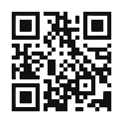


Stay connected with LSMS
GET UPDATES
worldbank.org/lsms
World Bank's Living Standards Measurement Study
lsms@worldbank.org

